Slide 1
Computing and Global Health Lecture 6 Patient Support
Winter 2015
Richard Anderson

Slide 2
Today’s topics
Trevor Perrier, SMS
Phone messaging
Messaging technologies
Example Projects
Messaging studies
Adherence
Health information systems

Slide 3
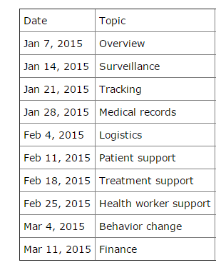
Readings and Assignments
SMS For Life
WelTel Study
Iron Tablet Adherence Study
Homework 6
Design an SMS syntax for cold chain reporting

Slide 4
Organization
Patient support
Treatment support
Worker support
Behavior Change Communication

Slide 5
Patient Support
Messaging
Spam
Reminders
Interaction
Adherence messaging
Adherence (other than messaging)
Information services

Slide 6
Phone Messaging
Different types of messaging
What is the intended behavior to be influenced
What is the theory of behavior change
Health knowledge
Promotion of a specific activity
Reminder of action
Interaction with health system

Slide 7
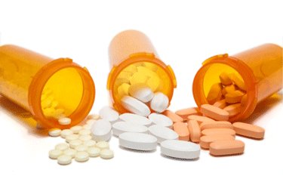
Adherence
Medication
HIV ART
Tuberculosis
Diabetes
Iron Pills
Lifestyle
Diet
(Not) smoking

Slide 8
Obstacles to Adherence
Why do people stop taking medication?

Slide 9
Reminders
Appointment reminders
ANC visits
TB Testing
Immunization reminders
Long term birth control

Slide 10
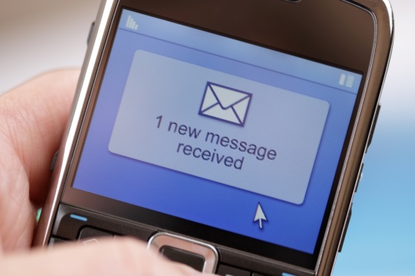
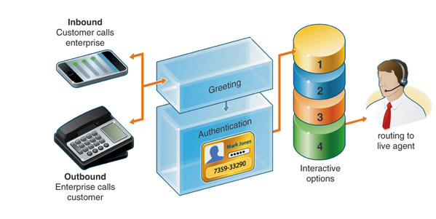
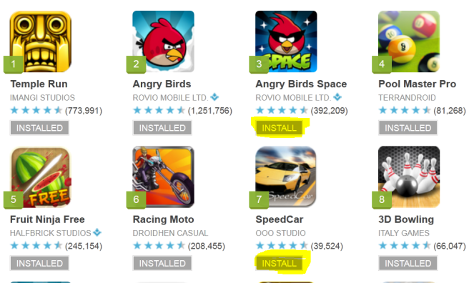
Technology
SMS, Voice, SmartPhone Apps, Social Media

Slide 11
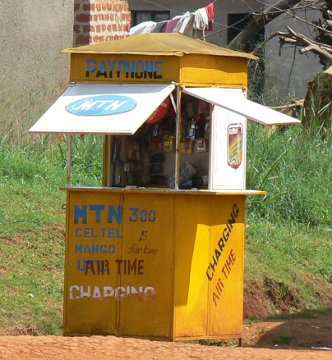
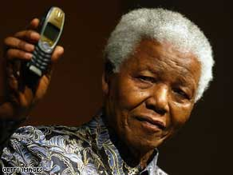
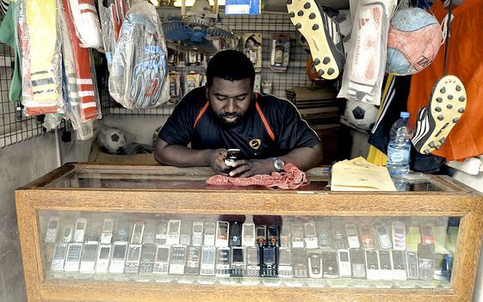
Personal mobile phones
Mobile phones have tremendous reach, but
Vast variety in different situations
Rapid change

Slide 12
Mobile Phone Issues
Handsets
Generally available, prestige good
Airtime
Prepaid. Costs vary dramatically
Signal
Widely available, spotty coverage, no coverage
Electrical power
Depends on the electrical grid
Simcards
Monopolies

Slide 13
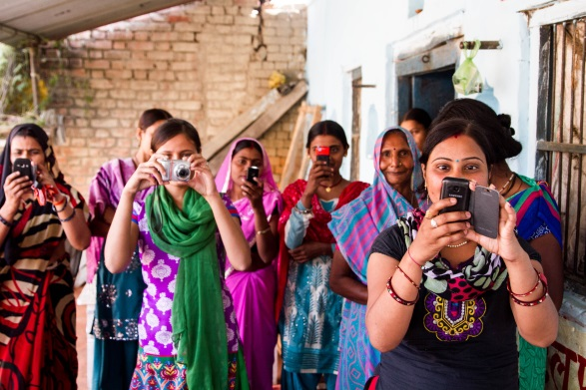
Mobile Phones and Gender
Phone ownership models
Shared across household (less common)
Household phone
Individual phones
Common practices
Men have better phones than women
Children have access to mothers phone

Slide 14
SMS
Available on almost all mobile phones
Restricted message length
Highly variable cost
Although essentially no cost for carrier
Highly variable usage
Different populations and countries
Gateway Issues
SPAM!

Slide 15
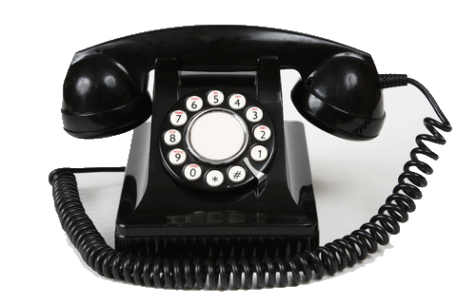
Voice
Universal on phones
IVR – Interactive Voice Response
Automated calls with recorded messages
Callbacks triggered by missed call

Slide 16
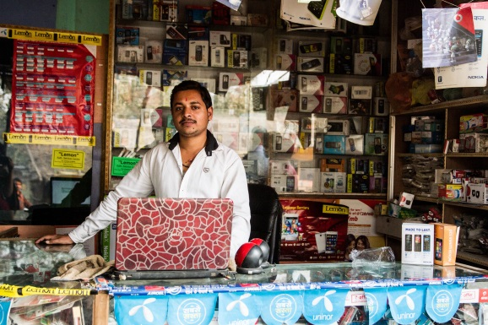
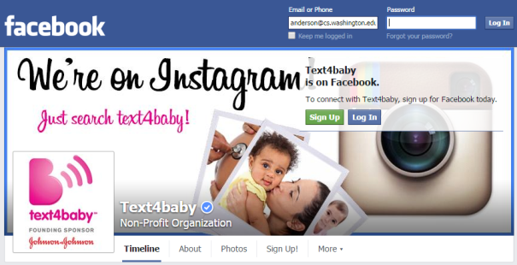
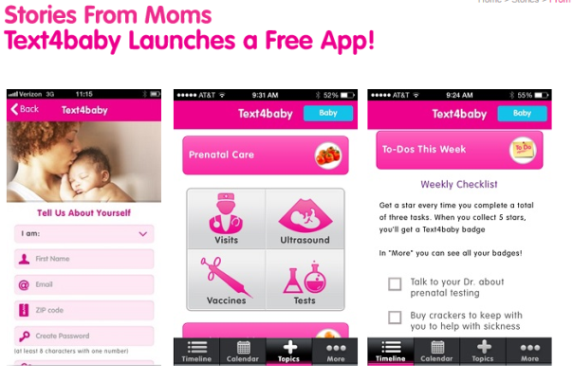
Smartphone Apps and Social Media
Applicability depends on demographics
Rapid change
For global health, often an emphasis in reaching late adopters

Slide 17
Example projects

Slide 18
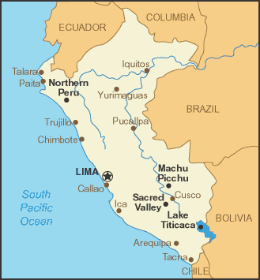
Walter Curioso
Early work in SMS reminders in Latin America
Voxiva
Messages aimed at high risk populations to influence behavior
Many issues around confidentiality and privacy

Slide 19
Text4Baby / MAMA
Free t4b msg: Morning sickness may be caused by a change in your hormones. Try eating crackers or dry cereal. Eat small meals often. Don’t go without eating.

Slide 20
Mobile Technology for Community Health (MOTECH)
Platform developed by Grameen Foundation with support from BMGF
Motechsuite.org
Evolving platform
Significant deployment through BMGF grantees in Bihar
Initial work in Ghana

Slide 21
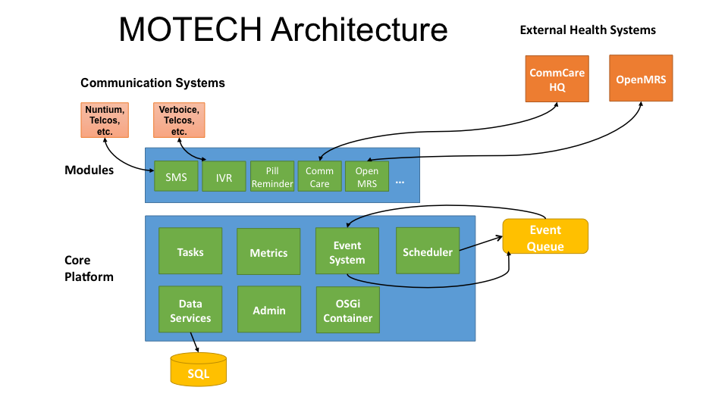
MOTECH Architecture

Slide 22
Motech Ghana
Initial deployment in Northern Ghana
Early version of Motech developed to support deployment
Maternal messaging and phones for nurses

Slide 23
Lessons learned
Phones for nurses
Phone management and logistics
Nurses did not feel the phones helped them in reporting
Messaging
Voice, not SMS
Tremendous challenges in localization
Expense for translation
Cost and sustainability challenges
Significant formative work in identifying needs

Slide 24
Evaluation Studies
Very different approaches to evaluation based on discipline
Medical evaluation
Define intervention
Construct study design
Enroll study subjects in different arms
Conduct study without further intervention
Computer Science
Develop technology with initial field tests
Deploy technology in field with iterative adjustments
Analysis of multiple sources of ad hoc data from deployment
Promote large scale deployment or use

Slide 25
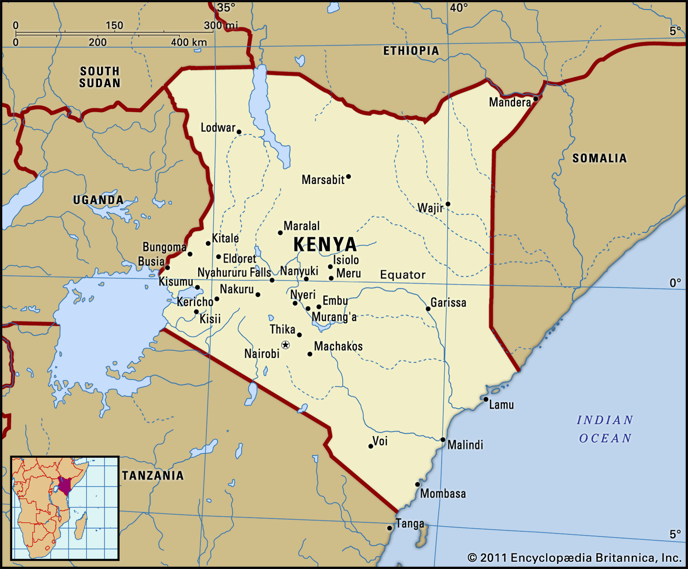
WelTel Study
HIV Patients on ART
Simple intervention
Send patients a weekly SMS: Mambo
Patients respond: Sawa / Shida
Measured outcomes
Self reported adherence
Viral suppression

Slide 26
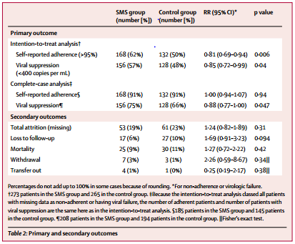
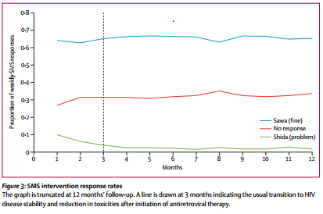
WelTel Study

Slide 27
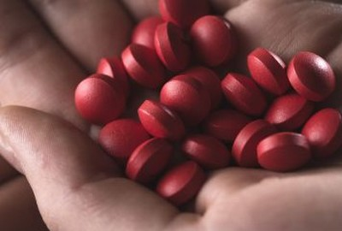
Adherence to Iron Pills
Evaluate if voice messaging improves adherence to taking pills
Study goal – evaluate mHealth intervention with measurable health outcome
Anemia is highly prevalent for low income women in India
Simple treatment – iron pills
Measurable results – Hemoglobin test

Slide 28
Sian Hospital Study
High anemia rates, low utilization of iron pills
Pills available for free, but 70% of women fail to take them
Forgetfulness, dislike of pills
Intervention
Recorded voice calls from doctor
Three messages per week in local language
Positive, affective messages
Hello, this is Dr. Niranjan Pai. We met in Sion Hospital. Your backache may increase. Don’t worry, take rest. Take the prescribed pills regularly as they are important for you and your child’s health. I will call you again in a couple of days. Thank you

Slide 29
Results
Slight positive results, treatment superior to control, but not statistically significant
What went wrong
Study failed to enroll sufficient number of subjects who completed study
Difficulty in following up to get final Hb
Early subjects had to be de-enrolled due to poor quality Hb measurements

Slide 30
How to do a literature review
Determine if there has been prior work on assessment of voice based adherence support in developing countries
On PubMed and IEEE Xplore, we included all studies that contained both an adherence keyword and a phone keyword in the title or abstract, with at least one of the keywords appearing in the title. For adherence keywords, we used “adherence”, “adhere”, “adhered”, “compliance”, “comply”, and “complied”. For phone keywords, we used “phone”, “phones”, “telephone”, “telephones”, “interactive voice”, “voice response”, “automated calls”, and “automated voice”.

Slide 31
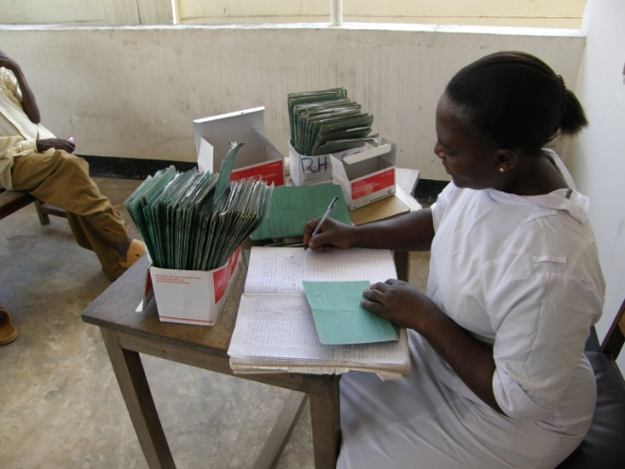
Adherence
Direct Observation Therapy

Slide 32
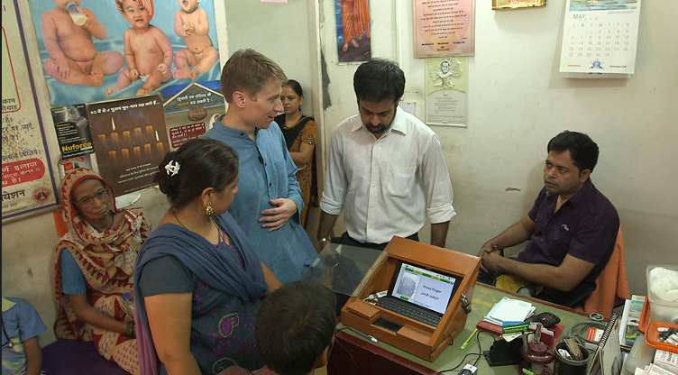
TB Drug Distribution
Fingerprint scanning in drug distribution

Slide 33
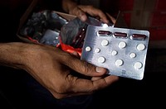
SMS Reporting
Send confirmation code associated with each pill

Slide 34
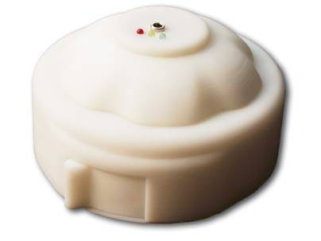
Pill box notifications

Slide 35
Health Information

Slide 36
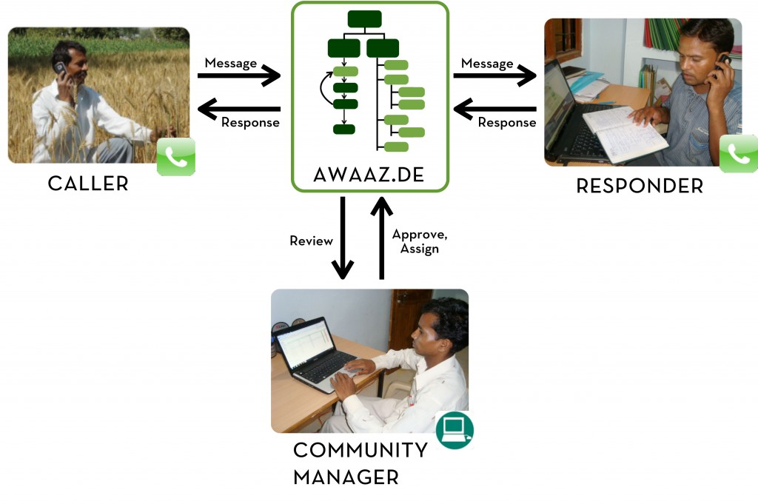
Awaaz De

Slide 37
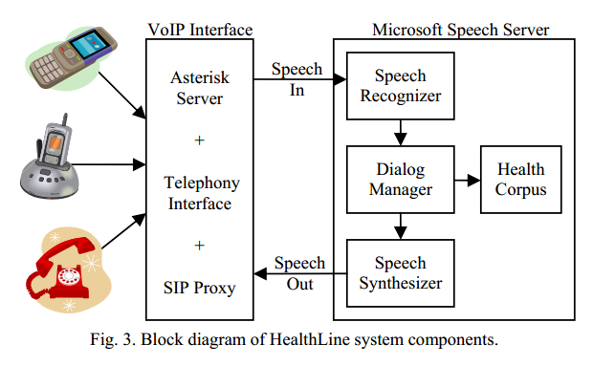
Health Line, Pakistan
Voice based health information system
Target low-literate users
Speech recognition research challenges

Slide 38
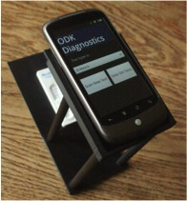
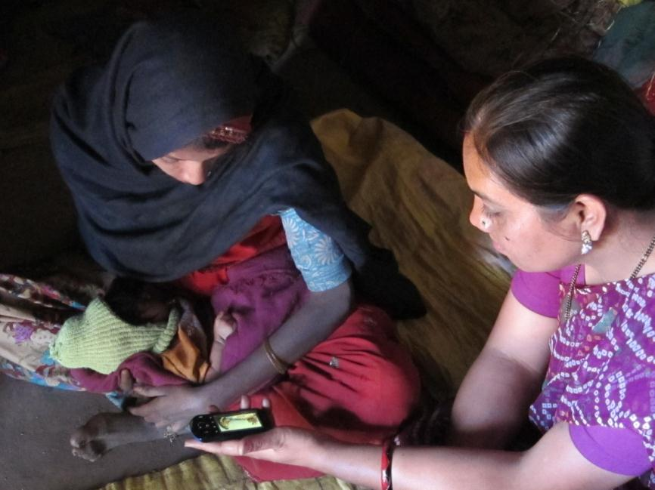
Next week
Treatment Support

